Slide 1
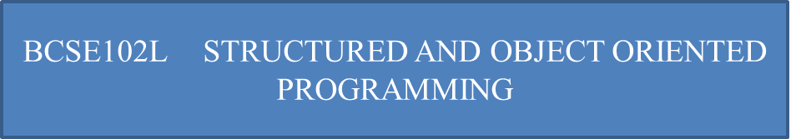

Polymorphism
The word polymorphism means having many forms.
polymorphism occurs when there is a hierarchy of classes and they are related by inheritance.
C++ polymorphism means that a call to a member function will cause a different function to be executed depending on the type of object that invokes the function.

Slide 2
Runtime or Dynamic Polymorphism
In runtime polymorphism, the compiler resolves the object at run time
it decides which function call should be associated with that object.
It is also known as dynamic or late binding polymorphism.
This type of polymorphism is executed through virtual functions and function overriding.
All the methods of runtime polymorphism get invoked during the run time.

Slide 3
Virtual Functions
Virtual functions are the member functions of the base class which are overridden in a derived class.
When you make a call to such a function by using a pointer or reference to the base class, the virtual function is called and the derived class’s version of the function gets invoked.

Slide 4
Virtual Functions
Virtual functions are only dynamic
They are declared within a base class by using the keyword “virtual”
These functions are called during run time
Virtual functions are always declared with a base class and overridden in a child class
Virtual functions can exist in the absence of inheritance. In that case, the base class version of the function will be called

Slide 5
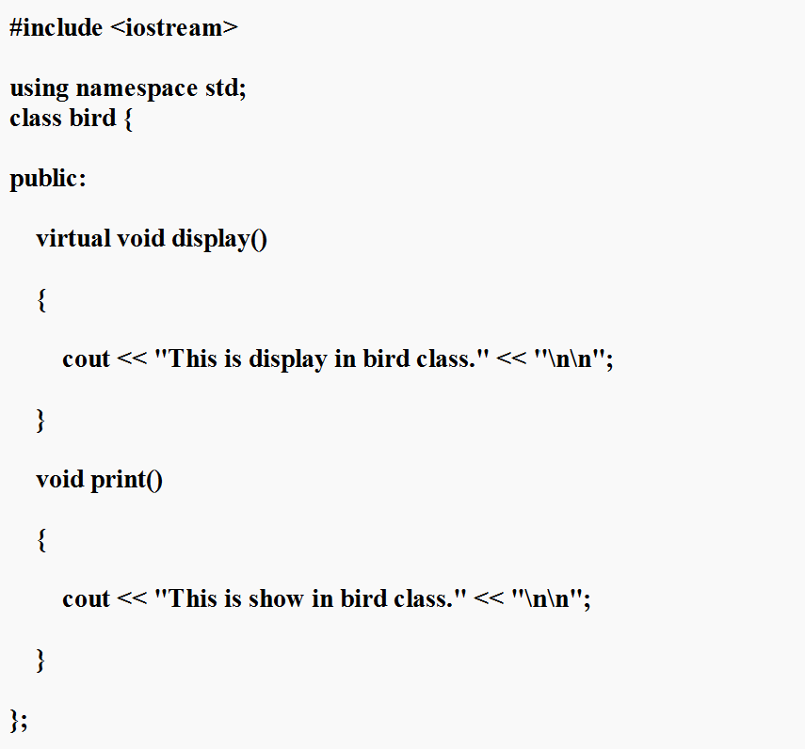
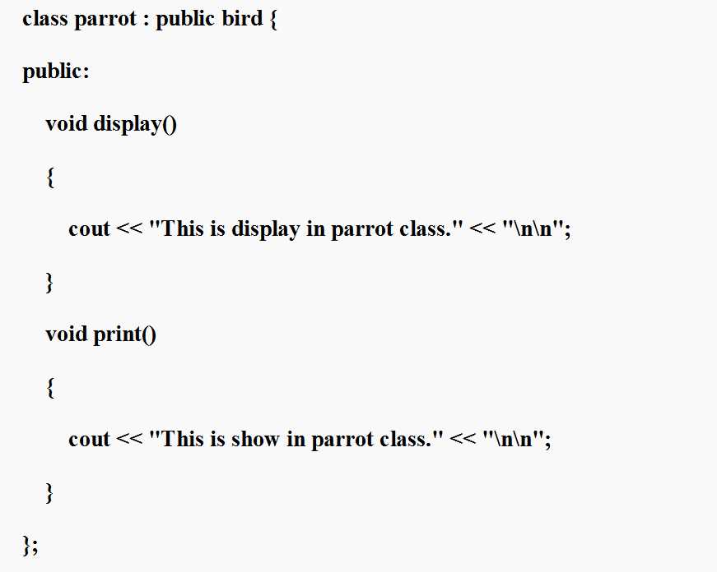

Slide 6
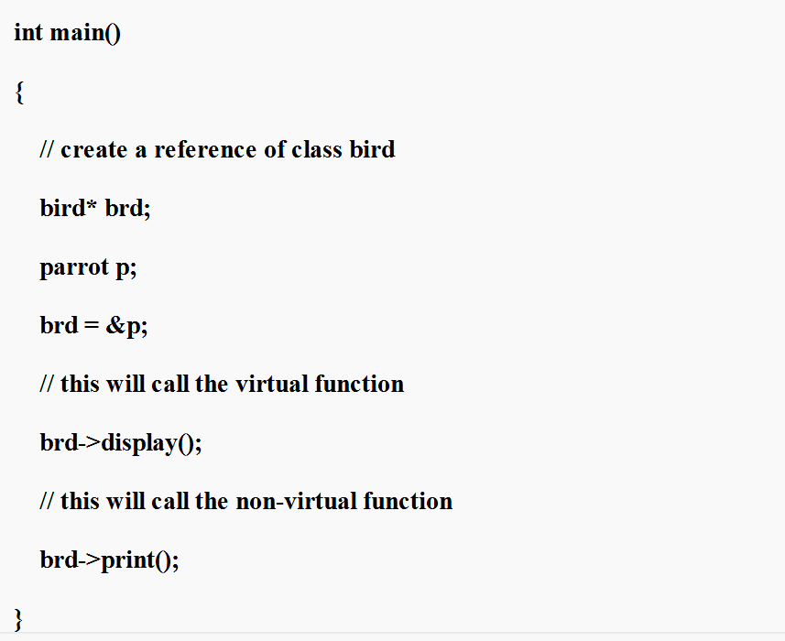
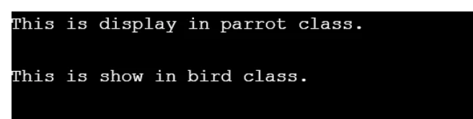
Virtual Functions

Slide 7
Pure Virtual Function
A pure virtual function is a virtual function in C++ for which we need not to write any function definition
only we have to declare it.
It is declared by assigning 0 in the declaration.

Slide 8
Pure Virtual Function- Syntax
class Test
{
// Data members of class
public:
// Pure Virtual Function
virtual void show() = 0;
};

Slide 9
Pure Virtual Function
#include<iostream>
using namespace std;
class B {
public:
virtual void s() = 0; // Pure Virtual Function
};
class D:public B {
public:
void s() {
cout << "Virtual Function in Derived class\n";
}
};

Slide 10
Pure Virtual Function
int main() {
B *b;
D dobj;
b = &dobj;
b->s();
}

Slide 11
Pure Virtual Function
int main() {
B *b;
D dobj;
b = &dobj;
b->s();
}

Slide 12
Abstract Class
An abstract class is a class in C++ which have at least one pure virtual function.
Abstract class can have normal functions and variables along with a pure virtual function.
Abstract class cannot be instantiated, but pointers and references of Abstract class type can be created.

Slide 13
Abstract Class
Abstract classes are mainly used for Upcasting, so that its derived classes can use its interface.
If an Abstract Class has derived class, they must implement all pure virtual functions, or else they will become Abstract too.

Slide 14
Abstract Class
Abstract classes are mainly used for Upcasting, so that its derived classes can use its interface.
If an Abstract Class has derived class, they must implement all pure virtual functions, or else they will become Abstract too.

Slide 15
Abstract Class
An abstract class in c++ is a class that contains at least one pure virtual function, and these classes cannot be instantiated.
Abstract Classes came from the idea of abstraction.

Slide 16
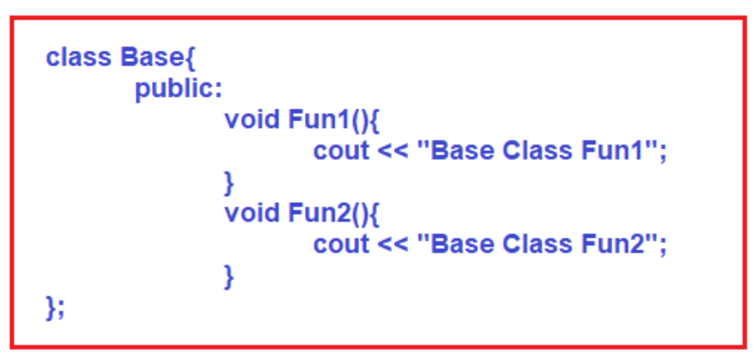
Abstract Class

Slide 17
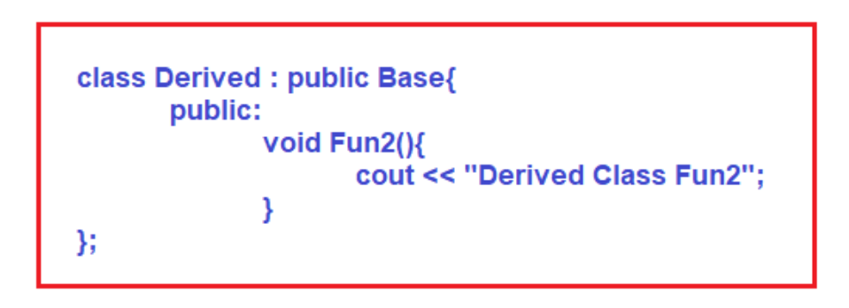
Abstract Class

Slide 18
Abstract Class

Slide 19
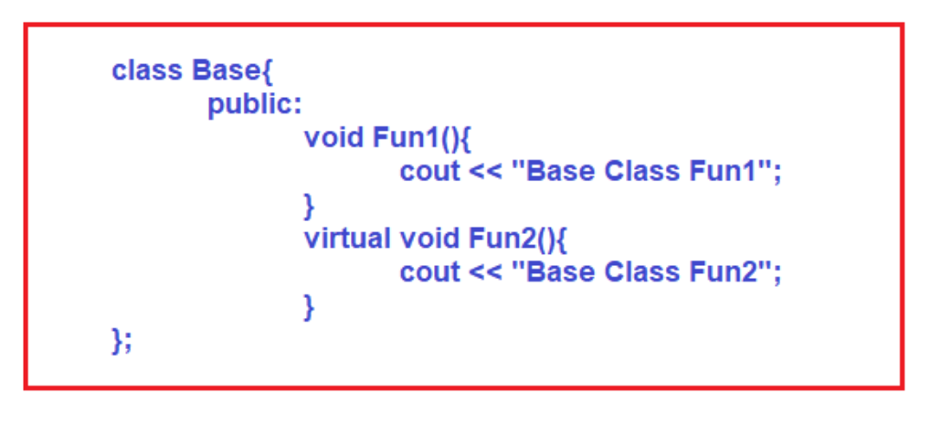
Abstract Class

Slide 20
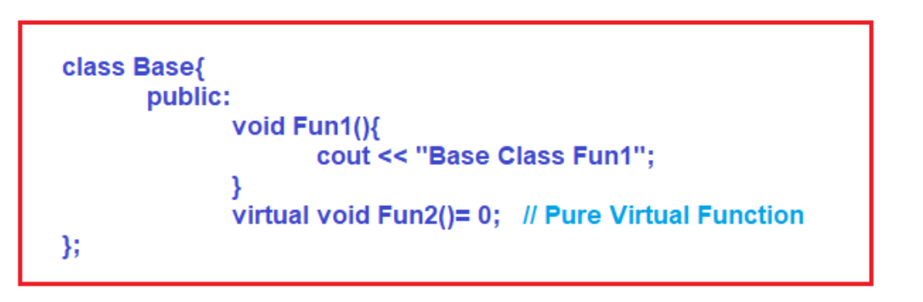
Abstract Class

Slide 21
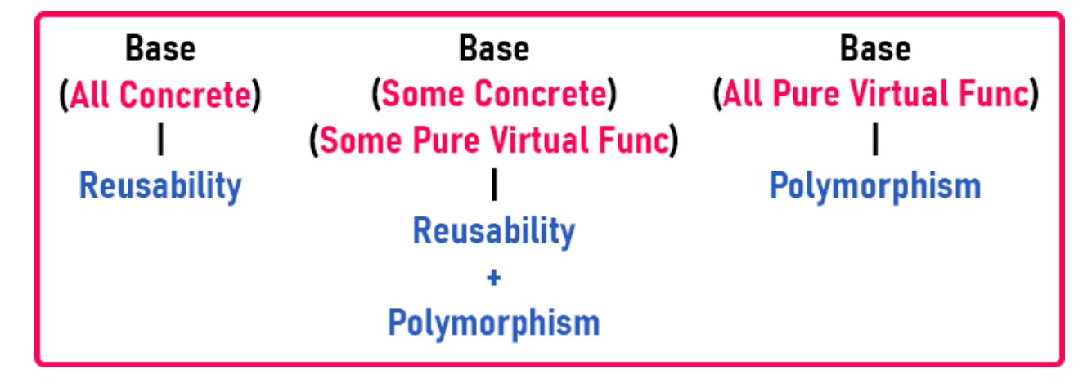
Abstract Class

Slide 22
Abstract Class
The class having a pure virtual function is an abstract class
An abstract class can have concrete also.
The object of abstract class cannot be created
A derived class must override pure virtual function, otherwise, it will also become an abstract class.
The pointer of the abstract class can be created
The pointer of the abstract class can hold the object of the derived class
Abstract classes are used for achieving polymorphism
The base class can be concrete
Abstract with some concrete and some pure virtual functions

Slide 23
Abstract Class
#include <iostream>
using namespace std;
class Base
{
public:
void Fun1()
{
cout << "Base Class Fun1"<<endl;
}
virtual void Fun2() = 0; // Pure Virtual Function
};

Slide 24
Abstract Class
class Derived:public Base
{
public:
void Fun2()
{
cout << "Derived Class Fun2"<<endl;
}};
int main()
{
Derived d;
d.Fun1();
d.Fun2();
return 0;}

Slide 25
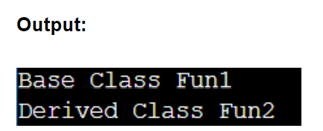
Abstract Class

Slide 26
The std is a short form of standard, the std namespace contains the built-in classes and declared functions.
we can find all the standard types and functions in the C++ "std" namespace.
There are also several namespaces inside "std."

Slide 27
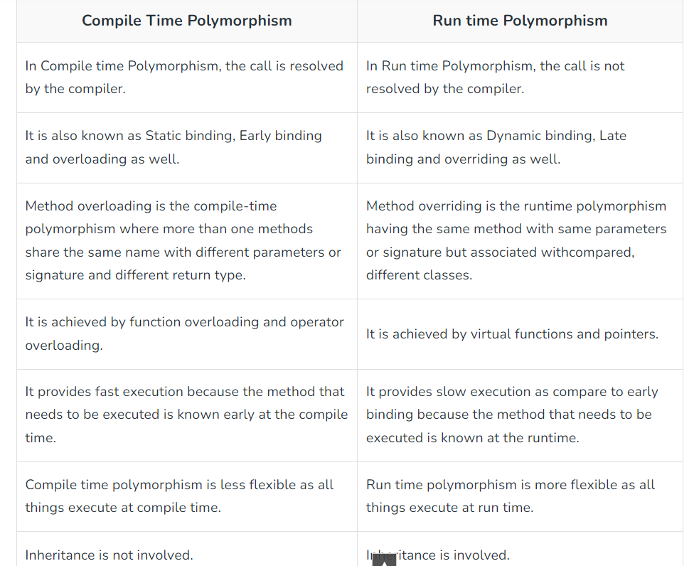

Slide 28
THANK YOU

